Slide 1

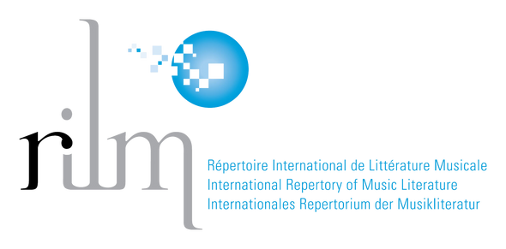
RILM in 2024
What’s New at RILM?
Elizabeth Martin-Ruiz
Sales & Subscriptions
emartin@rilm.org
Répertoire International de Littérature Musicale
International Repertory of Music Literature
Internationales Repertorium der Musikitetur
www.rilm.org
Notes:
Dear colleagues, good morning!
My name is Liz Martin-Ruiz, I handle sales and subscriptions at RILM, as well as help with some backend technical projects.
2024 is a very exciting year for us with new developments across all RILM’s products. I am very pleased to be here and walk you through RILM’s updates.

Slide 2






RILM Reference Resources
EBSCOhost Platform
RILM Abstracts of Music Literature (1967)
RILM Music Encyclopedias (RME) (2015)
RILM Abstracts with Full Text (RAFT) (2016)
RILM Index to Printed Music (2019)
How to Write about Music: The RILM Manual of Style (2023)
RILM’s EGRET Platform
MGG Online (2016)
RILM Music Encyclopedias (RME) (2020)
DEUMM Online (forthcoming in 2024)
RILM Archive of Popular Music Magazines (RAPMM) (forthcoming in 2024)
Répertoire International de Littérature Musicale
International Repertory of Music Literature
Internationales Repertorium der Musikitetur
www.rilm.org
Notes:
This is our list of resources, divided by the platform they are available on. The products highlighted in yellow are our newest and upcoming releases.

Slide 3



Répertoire International de Littérature Musicale
International Repertory of Music Literature
Internationales Repertorium der Musikitetur
www.rilm.org
Notes:
The RILM Abstracts database has been rapidly growing, both in content and in numbers.

Slide 4
RILM Abstracts with Full Text
Forty new full-text journals added since 2020 in four annual installments
The full text of 280 journals (475,000 full-text records)
Fifth annual addition: Ten new titles forthcoming in July 2024
Répertoire International de Littérature Musicale
International Repertory of Music Literature
Internationales Repertorium der Musikitetur
www.rilm.org
Notes:
The full-text enhancement of RILM Abstracts originally launched in 2016 with 240 FT.
Since then, a total of 40 new FT journals have been added in four annual installments, bringing the FT collection to the current 280 journal titles, with over 475,000 PDFs available through EBSCO.
Next month, ten new full-text journal titles will be released.

Slide 5
RILM
2024 Additions
EXCLUSIVE
A handbook for studies in 18th-century English music
(London: Gerald Coke Handel Foundation, 1987–)
Haydn yearbook / Das Haydn Jahrbuch
(Bryn Mawr: Theodor Presser Company, 1962–1978)
Muzikologické fórum: Časopis České společnosti pro hudební vědu
(Praha: Česká Společnost pro Hudební Vědu, 2012–)
Muzikos komponavimo principai / Principles of music composing
(Vilnius: Lietuvos Muzikos ir Teatro Akademija, 2001–)
Southern music education journal
(Jackson: University of Mississippi, 2004–2010)
Répertoire International de Littérature Musicale
International Repertory of Music Literature
Internationales Repertorium der Musikitetur
www.rilm.org
Notes:
These new additions include periodicals published in Australia, Chile, Lithuania, and Belgium, among others.
When we license new journals for RAFT and select titles for annual release, we follow three major criteria: one of which is limited availabity, and, five of the forthcoming new titles are not available on any other online platform .

Slide 6



Répertoire International de Littérature Musicale
International Repertory of Music Literature
Internationales Repertorium der Musikitetur
www.rilm.org
Notes:
Our other indexing resource, IPM, is the digital finding aid for locating musical works contained in collections, sets, and series. You will find bibliographic records for each volume as well as granular details for each individual piece of music in said volume, like genre, score format, opus and catalog numbers.

Slide 7
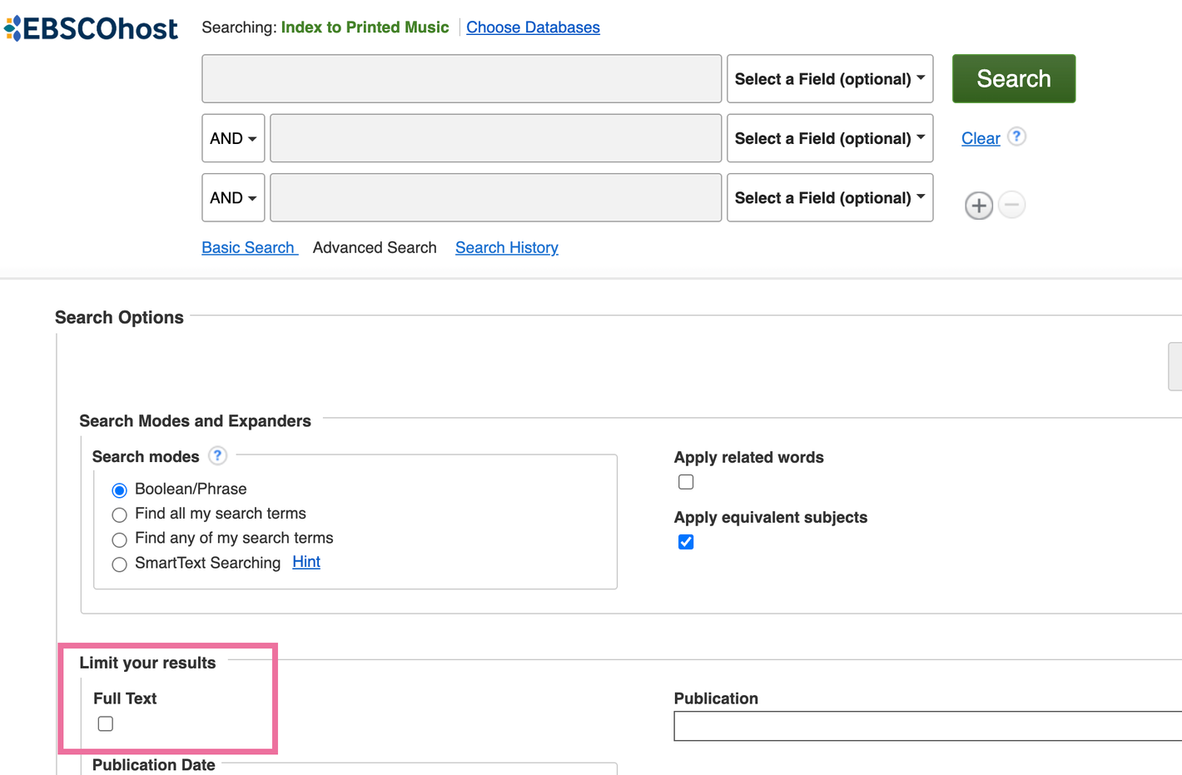
WHAT’S NEW
Full-text limiter box
Improved instrument search and access point
Updated practical editions field
Répertoire International de Littérature Musicale
International Repertory of Music Literature
Internationales Repertorium der Musikitetur
www.rilm.org
Notes:
With more musical scores appearing in digital formats, IPM's mission has expanded to now include indexing digital, open-access editions where available. These scores are now easily searchable thanks to a full-text limiter button on the search screen, shown here.
Currently there are just over 10,000 records with full-text links, with more being added regularly

Slide 8
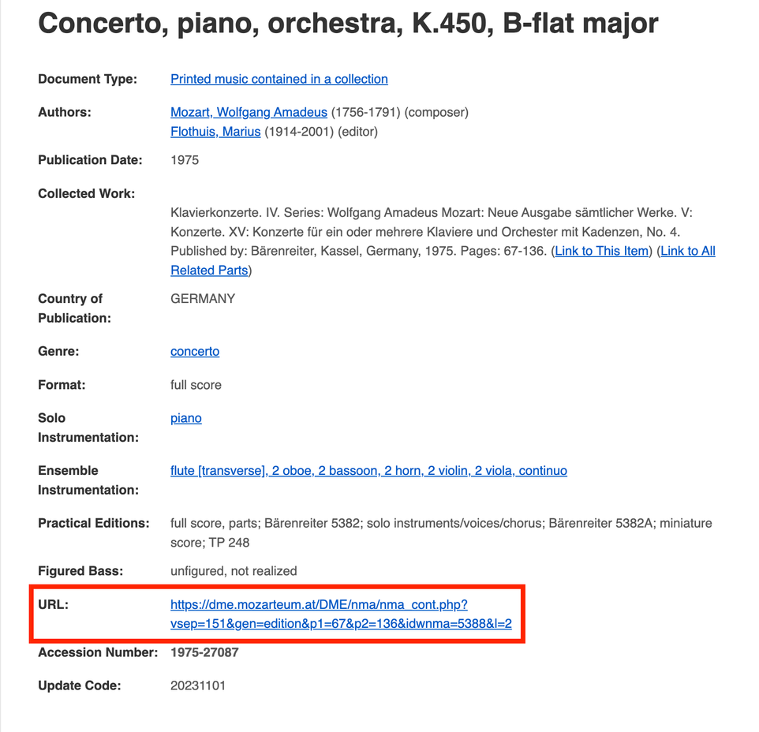
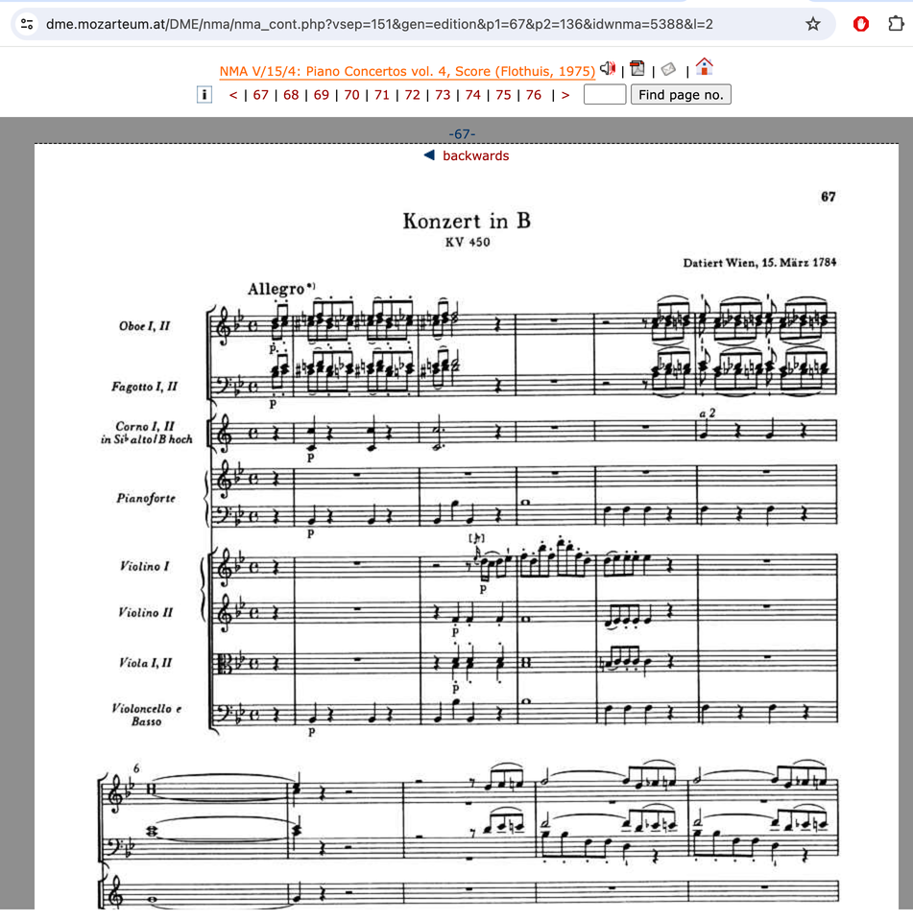
Links to Open-Access Full-Text Scores
Répertoire International de Littérature Musicale
International Repertory of Music Literature
Internationales Repertorium der Musikitetur
www.rilm.org
Notes:
Let's say you are searching for Mozart's piano concerto, K.450; you find the record and see that in the URL field there is a direct link to the score. (Outlined here in the red box) Clicking the link opens to the desired piece (shown on the right). These links are available for the complete run of the NMA and also for other series like the English Heritage Music Series, Carl Nielsen Edition, Fontes musicae in Polonia, and early editions of the complete works of Mendelssohn, Liszt, Schubert, Händel, Beethoven, and Schumann.

Slide 9



Répertoire International de Littérature Musicale
International Repertory of Music Literature
Internationales Repertorium der Musikitetur
www.rilm.org
Notes:
Besides indexing, we have several full text reference resources. RILM Music Encyclopedias, our music encyclopedia collection, has four new entries for 2024. This brings the total to 69 full-text dictionaries and encyclopedias that span multiple countries, languages, and music-related topics.

Slide 10
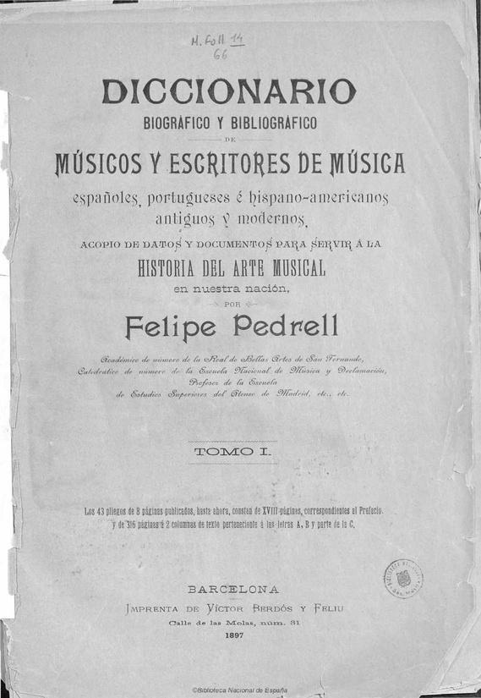
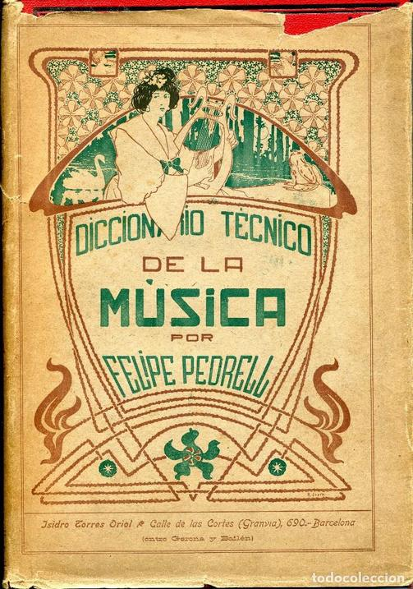
RILM Music Encyclopedias (RME)
2024 Additions
Felipe Pedrell, gen. ed. Diccionario biográfico y bibliográfico de músicos y escritores de música españoles, portugueses e hispano-americanos antiguos y modernos
(1st ed.; Barcelona: Tipografía de Víctor Berdós y Feliú, 1897)
Felipe Pedrell, gen. ed. Diccionario técnico de la música
(1st ed.; Barcelona: Isidro Torres Oriol, 1894)
Répertoire International de Littérature Musicale
International Repertory of Music Literature
Internationales Repertorium der Musikitetur
www.rilm.org
Notes:
We have two Spanish-language dictionaries edited by Felipe Pedrell in the 1890s. Pedrell was a music critic and music historian and is considered to be one of the fathers of contemporary Spanish music and musicology. These two works, conceived and created in succession, are important Spanish-language musicological texts that reflect musical knowledge at the turn of the 20th century.
Diccionario tecnico, in particular, contains nearly 10,000 entries of genre, form, and instrument definitions, especially including those specific to the Spanish and Hispanic realm.

Slide 11

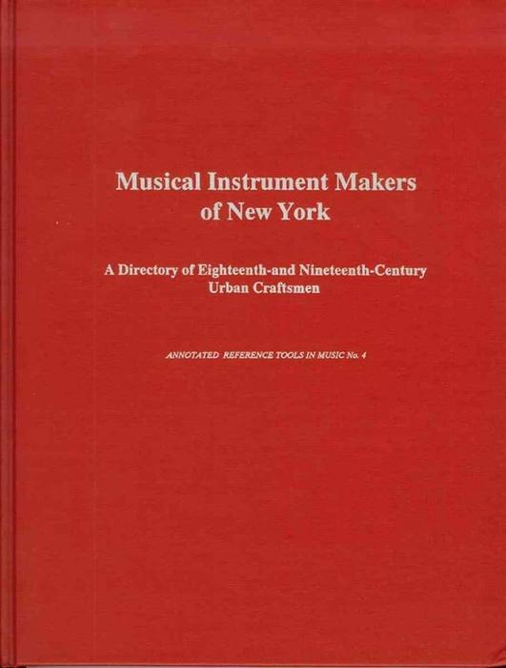
RILM Music Encyclopedias (RME)
2024 Additions
Warren Bebbington, ed.
A dictionary of Australian music (Melbourne: Oxford University Press, 1998)
Nancy Groce.
Musical instrument makers of New York: A directory of eighteenth and nineteenth century urban craftsmen (Stuyvesant, NY: Pendragon Press, 1991)
Répertoire International de Littérature Musicale
International Repertory of Music Literature
Internationales Repertorium der Musikitetur
www.rilm.org
Notes:
The other two entries for 2024 are in English:
A dictionary of Australian music covers a wide spectrum of topics, from ancient Aboriginal traditions to Australian folk and jazz music. It includes entries on composers, performers, pop and rock groups native to Australia as well as leading musicologists, critics, broadcasters, educators, and researchers.
Musical instrument makers of New York chronicles craftsmen from the obscure luthier Geoffrey Stafford in 1691 to the plethora of instrument makers at the height of the city's instrument production in the 1890s, through to the Depression era. Aside from providing a record of these instrument makers, the dictionary offers a historical study of an urban trade that is ultimately tied to the growth and development of the city.

Slide 12




Répertoire International de Littérature Musicale
International Repertory of Music Literature
Internationales Repertorium der Musikitetur
www.rilm.org
Notes:
MGG Online was the first resource to launch on the platform seven years ago, and since then it has seen hundreds of new and newly written articles.
MGG Online’s new content is increasingly shaped by a move from updating existing articles to adding new articles and incorporating new subject areas. New articles align with MGG Online’s long-term thematic commitment to adding articles on topics about North America, classical singers, contemporary composers and performers, and popular musicians, which continues into 2024. Furthermore, new versions of large-scale articles such as those on Beethoven, Haydn, and the Romantic era are in preparation.

Slide 13
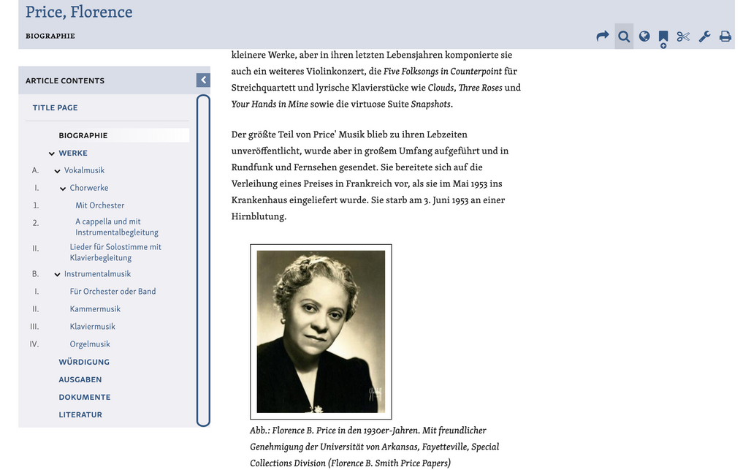
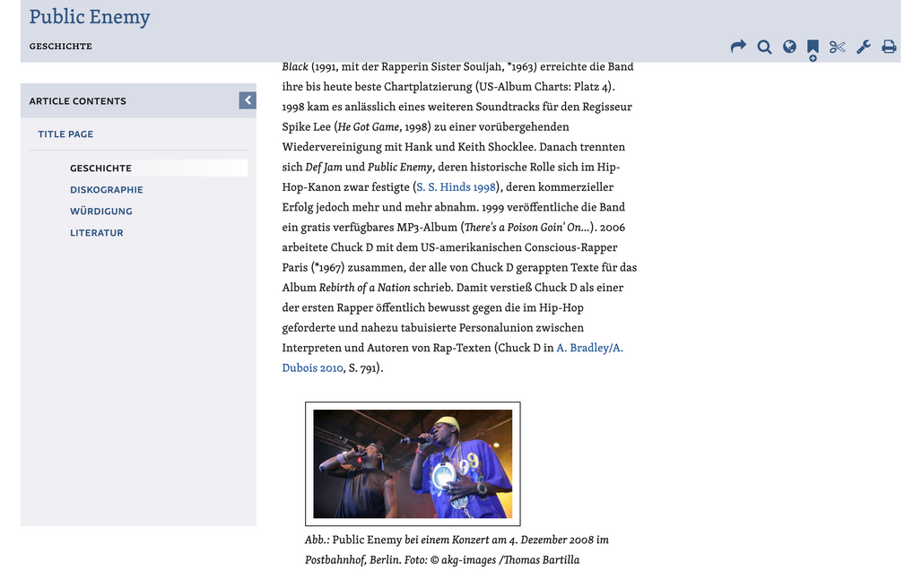
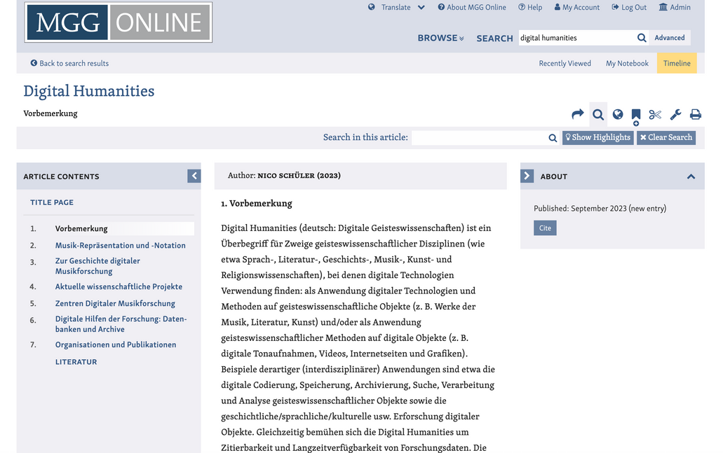
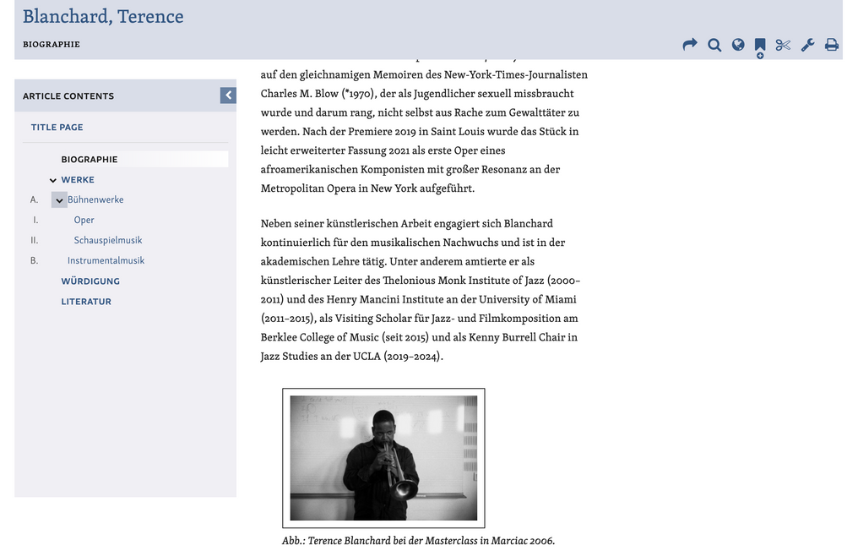
MGG Online
New Additions
Répertoire International de Littérature Musicale
International Repertory of Music Literature
Internationales Repertorium der Musikitetur
www.rilm.org
Notes:
In 2023, a highly productive year for MGG Online, new entries included composer Florence Price, contemporary composer Terrence Blanchard, and popular music group Public Enemy, among many more. Of special note is a comprehensive topic article on digital humanities. The scope of these articles, which includes thorough works lists, bibliographies, and topic insights, brings rich new content to the encyclopedia collection.

Slide 14
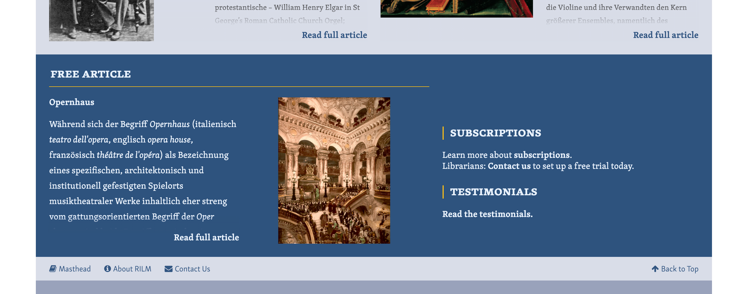
MGG Online
Exclusive Free Article
Répertoire International de Littérature Musicale
International Repertory of Music Literature
Internationales Repertorium der Musikitetur
www.rilm.org
Notes:
The site also added a free article that can be found on mgg-online.com and demonstrates all of MGG Online’s functionalities within a single entry. It was first set to Geesa zur Nieden’s s discussion of the opera house and now highlights the article on Arnold Shonberg. This free article will be replaced on a regular basis, so please check back to see more free content.

Slide 15




Répertoire International de Littérature Musicale
International Repertory of Music Literature
Internationales Repertorium der Musikitetur
www.rilm.org
Notes:
Adding to the encyclopedia offering for RILM is DEUMM Online. In 2021, RILM acquired full rights to the entire content of this important universal Italian-language music encyclopedia.
DEUMM is one of only five existing large national encyclopedias of music and as such it is very exciting that two of them will be now available on RILMs platform EGRET, where DEUMM will join MGG Online.

Slide 16
Dizionario enciclopedico universale della musica e dei musicisti
Three encyclopedic sets (17 volumes)
Il lessico, 4 volumes (1983–1984)
musical terms, genres, currents and historical periods instruments, dance, metrics, acoustics
Le biografie, 10 volumes (1985–1985; 1990; 2005)
biographies and evaluation of works and activities of some 5000 composers, musicians, and librettists
I titoli e i personaggi, 3 volumes (1999)
Répertoire International de Littérature Musicale
International Repertory of Music Literature
Internationales Repertorium der Musikitetur
www.rilm.org
Notes:
Dizionario enciclopedico universale della musica e dei musicisti, (DEUMM) was published in print between the 1980s and 2005 under the editorship of Alberto Basso.
The original DEUMM encyclopedia was published in 17 volumes, divided in three sections, …

Slide 17
DEUMM Online Launch Breakdown
About 35,000 articles
20,000 entries for individuals and families of musicians
6,500 entries for individual musical works
2,400 definitions of music works
1,600 instruments
550 musical genres
500 dances
250 organ registers
Répertoire International de Littérature Musicale
International Repertory of Music Literature
Internationales Repertorium der Musikitetur
www.rilm.org
Notes:
…containing a total of some 35,000 entries
All of the original content has been scanned, tagged with semantic tags, and imported in RILM’s EGRET editorial platform.

Slide 18

What will make DEUMM Online Special
Updates
333 newly written or updated articles commissioned
150 newly written entries per year
80 newly written or updated articles published
Features
English-Italian interface and Google Translate
Citations of the article in a variety of formats
Links to other versions of the article
Links to related content across RILM products
Répertoire International de Littérature Musicale
International Repertory of Music Literature
Internationales Repertorium der Musikitetur
www.rilm.org
Notes:
Adding to the print content, DEUMM Online includes new and Updated content …
It also bring essential New features that make DEUMM Online easy to use.
All our encyclopedic products, including DEUMM Online, will be continuously supplemented with new and updated entries reflecting new trends in music scholarship with a significant portion of added entries on subjects, particularly in the areas of popular music, film music, jazz, traditional music, and world music.

Slide 19



Répertoire International de Littérature Musicale
International Repertory of Music Literature
Internationales Repertorium der Musikitetur
www.rilm.org
Notes:
And we have one more resource joining the Egret platform. We are very excited to announce RAPMM, the RILM Archive of Popular Music Magazines. It houses a digital collection of independently published popular music magazines and fanzines that are not readily available in libraries and archives. Scheduled to launch in late fall of 2024, RAPMM will bring together approximately 125 of these publications in one place, with front-to-back issues of titles scanned directly from their sources in high resolution and made available in digital form. This represents 2,000 issues, or 100,000 pages, in multiple languages and from different countries. The coverage ranges from the 1970s to the present day.

Slide 20

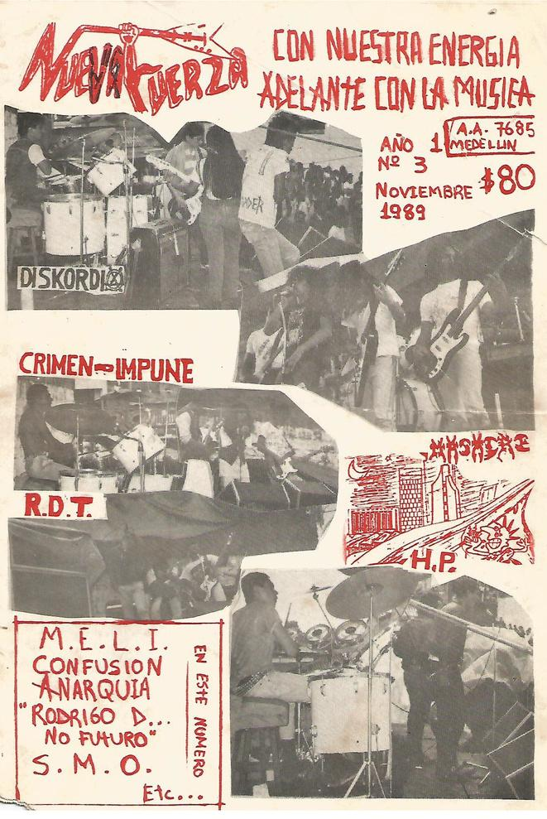

RAPMM will include 125+ titles, including…
Répertoire International de Littérature Musicale
International Repertory of Music Literature
Internationales Repertorium der Musikitetur
www.rilm.org
Notes:
The collection offers a wide spectrum of publications from familiar mainstream independent publishers to niche magazines and fanzines. Carefully curated, RAPMM, in line with RILM’s mission, seeks to document the world’s knowledge about music as covered by zines, with publications from countries such as Australia, Canada, China, Colombia, Germany, Spain, the United Kingdom, and the United States.

Slide 21
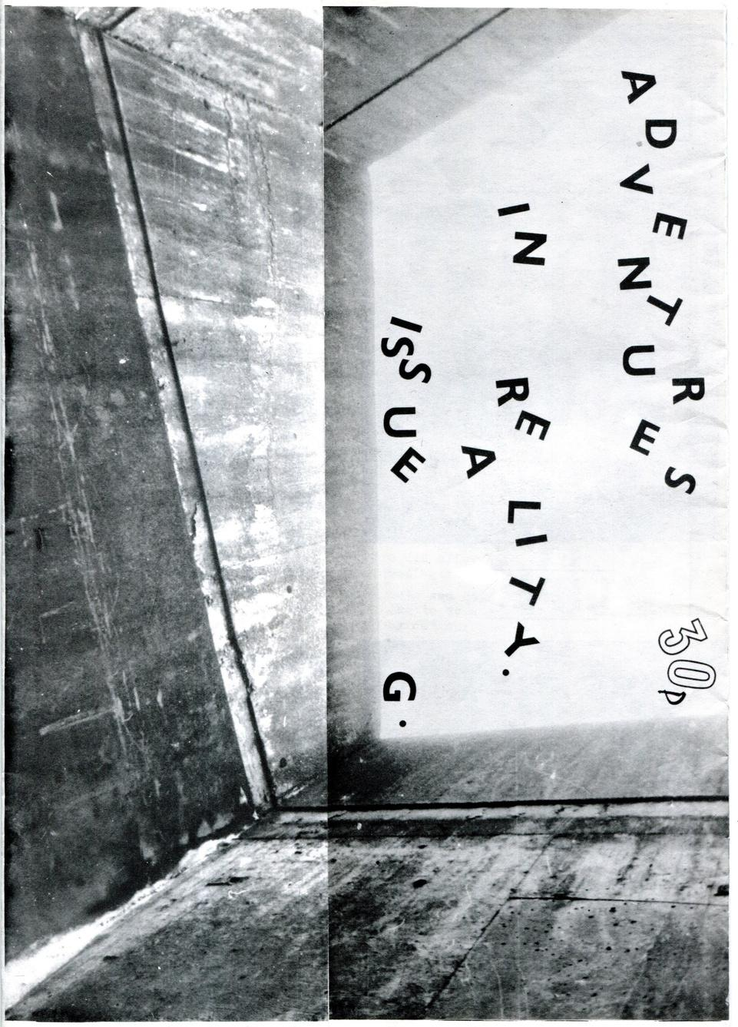


RAPMM will include 125+ titles, including…
Répertoire International de Littérature Musicale
International Repertory of Music Literature
Internationales Repertorium der Musikitetur
www.rilm.org
Notes:
The zines offer first-hand accounts of musical scenes written by journalists, critics, artists, and fans. Some zines trace musical aesthetics, genres, and particular scenes where the publication's culture emerged, such as London, New York, and Los Angeles. Others address topics such as sound production and musical instruments. The content of RAPMM documents historical and current data, musical contexts, and worldviews of the creators’ lived experiences.

Slide 22

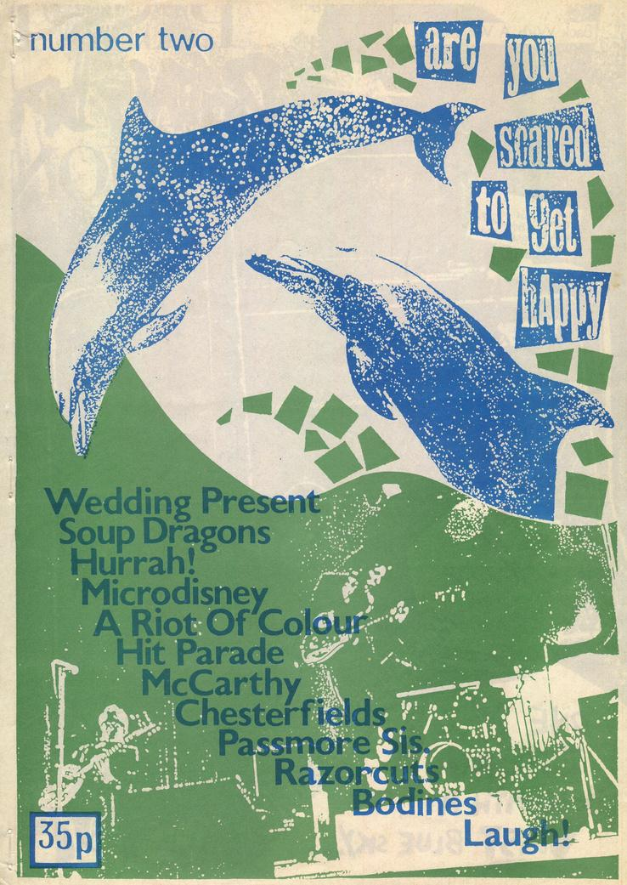

RAPMM will include 125+ titles, including…
Répertoire International de Littérature Musicale
International Repertory of Music Literature
Internationales Repertorium der Musikitetur
www.rilm.org
Notes:
These publications include:
● Articles on the history of musical movements and their relation to politics and society, social movements from punk to feminism, subcultures, and stylistic shifts
● Interviews
● Band profiles
● Album reviews and charts, and history of record labels
● Topics that traverse a wide range of popular music genres, including punk, rock, indie music, post-punk, grunge, hip hop, women’s music, world music, psychedelia, noise, alternative music, jazz, and country music

Slide 23


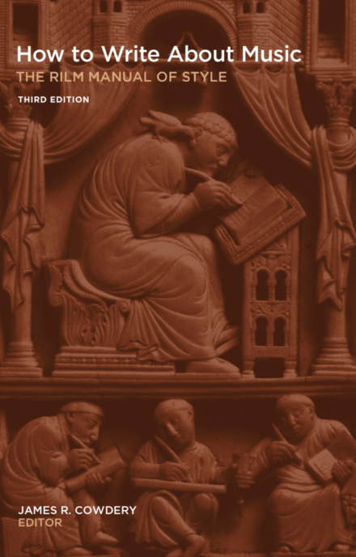
How to Write About Music
The RILM Style Guide
Available for purchase through
EBSCOhost Collection Manager and GOBI
Contact ebookinfo@ebsco.com
or your EBSCO sales representative
Répertoire International de Littérature Musicale
International Repertory of Music Literature
Internationales Repertorium der Musikitetur
www.rilm.org
Notes:
Moving on to our more recent endeavor, we have begun publishing several of our print publications digitally. A year ago we launched the third edition of The RILM Manual of Style, only available in an e-book format. There are several ways of accessing the manual, … More of RILM’s publications are being prepared for e-book publication in the near future.

Slide 24

Keep in Touch w/RILM
Répertoire International de Littérature Musicale
International Repertory of Music Literature
Internationales Repertorium der Musikitetur
www.rilm.org
Notes:
Thank you for listening to RILM’s latest updates. This handy QR code will take you to our Linktree with more information on all the resources I spoke about.
I’m happy to answer any questions now.

